Slide 1
Building a New Life
Starting Out
Notes:
Instructor:
Read through the whole lesson (including all the notes) before the day of class
Make note of and gather any supplies you need to bring
Prepare examples, stories
Think through how much time you want to spend on individual activities; make notes
Be sure to allow time to announce the assignment at the end
Overview:
Intro (slides 1-4): 1-2 minutes
Life after college (5-17): 10-15 minutes
Starting fresh (18-26): 15-20 minutes
Roughing it/Grit (27-37): 15-20 minutes
Wrap-up (38-40): 1-2 minutes
Total: 42-60 minutes

Slide 2
Pre-work
Before coming to class, complete the following:
Strengthen your resume – as much or as little as you want.
Answer the question “Tell me about yourself” to 3-5 different people from different areas of your life (family, friends, roommates, colleagues, etc.)
Give yourself a grade for completion and effort
Notes:
Have students keep a record each week of participation and homework grades—they will report self-scores at mid-term and final

Slide 3
Review
What did we go over last class?
Sell Your Skills
The power and importance of a strong resume
Sharpening your interviewing skills

Slide 4
Today
Objectives:
Discuss potential difficulties with life after college
Walk through the process of moving to a new place and starting out fresh
Discuss the role of grit in starting something new

Slide 5
Life after college
Notes:
Overview:
Intro (slides 1-4): 1-2 minutes
Life after college (5-17): 10-15 minutes
Starting fresh (18-26): 15-20 minutes
Roughing it/Grit (27-37): 15-20 minutes
Wrap-up (38-40): 1-2 minutes
Total: 42-60 minutes

Slide 6
Hypothetical
So, we’ve talked the past few weeks about:
The importance of ACME students in the economy, and your potential for great things
Getting a great job through networking, strong resumes, interviewing skills, etc.
Let’s assume that you did it! You nailed the interview and got the job with an excellent company. You will start immediately after graduation (which is in just a few weeks).

Slide 7
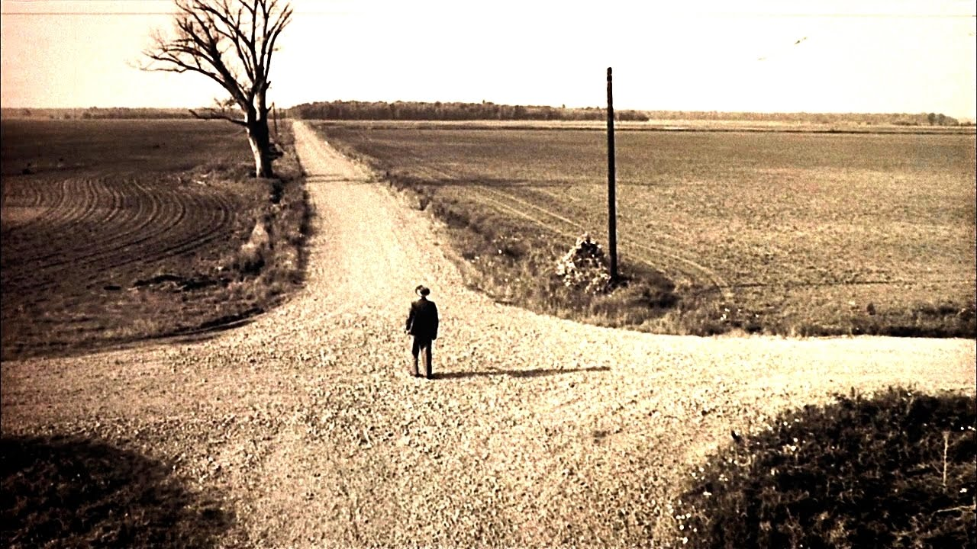
…now what?

Slide 8

Change
By now, you’re probably feeling at least somewhat comfortable with your current situation:
Context (city, state, culture, climate)
Friends (roommates, study group, *Dungeons and Dragons club, etc.)
Class, work, etc.
The routine
It can be quite difficult to change all of those things, especially all at once
*not required for ACME students
Notes:
Image from commons.wikimedia.org

Slide 9
The list
Once you graduate, there is a list of things to figure out:
Find a new place to live
Apartment? House?
Single with roommates? No roommates? Married? Kids?
Get to know the city
What’s are people like? Is it expensive to live there?
Learn the job
New coworkers, policies, bosses, responsibilities
Etc.

Slide 10

Building a new life
You will be building a new life for yourself, which might be very different from your current life.
Notes:
Image from pixabay.com

Slide 11

Discuss
What worries you about life after graduation?
Notes:
Pairs, small groups, or whole class discussion
1-2 minutes
Image from en.wikipedia.org

Slide 12

Discuss
What are you looking forward to about life after graduation?
Yes, change can be hard, but it can be great, too!
Notes:
1-2 minutes

Slide 13
Activity
Write down, in as much detail as you’d like, what you’d like your life to be like after college
Who will you work for?
Where will you live?
How much money will you earn?
Will you be married?
Etc.
Notes:
Take 1-3 minutes

Slide 14



Share
What will your life be like?
Notes:
1-2 minutes
Images from unsplash.com, pixabay.com, startupstockphotos.com

Slide 15

Life after college might seem very appealing
It might be easy to want it to come too soon
That said, let’s think about now, too!

Slide 16
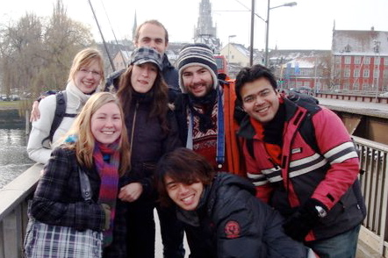
Activity
Write down, in as much detail as you’d like, what you’d like your life to be like now
Where do you want to live?
With whom?
What grades do you hope to earn?
What clubs might you like to join?
What can you do now to prepare for life post-college?
Notes:
1-3 minutes
Image from en.wikipedia.org

Slide 17
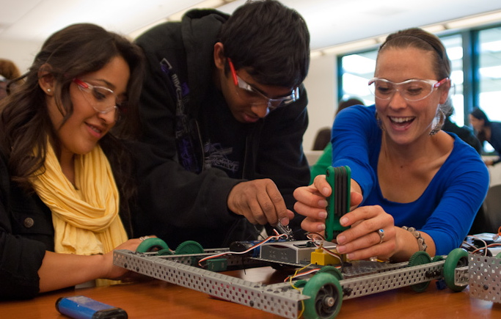
Take-away
The things that you do now will have a big effect on what happens later
Notes:
Image from en.wikipedia.org

Slide 18
Starting out fresh

Slide 19

Finding a Place
Eventually, you’ll graduate, get a job, and have to move
Will you be ready to find and finance a place?
Notes:
Image from unsplash.com

Slide 20
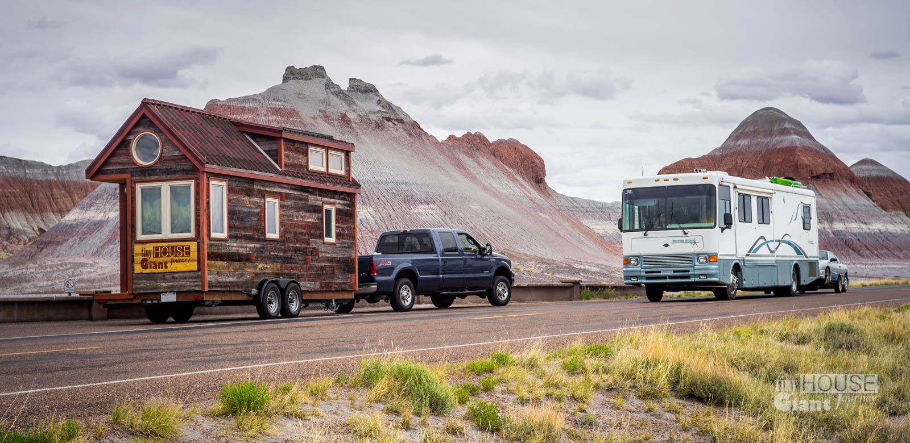
Tips
We’re going to work together to learn more about the home buying process.
We realize that this isn’t happening right away, but knowing a few tips can help you when the time comes
Notes:
Image from en.wikipedia.org

Slide 21
Group Activity
Research the home buying process online (Recommended: Realtor.com videos)
Use the board to illustrate the home buying process
Share with the class. In your presentation, address the following questions:
What is the general outline of the process?
What are a few important details?
How can we learn more?
Each person must contribute to the presentation:
Research
Drawing
Writing
Sharing
Notes:
(5-10 minutes for preparation; 3-5 minutes to share)
Groups of 3-4 would work well.

Slide 22

Tips
Great work!
You won’t need to know these things right away, but when you do we hope that you’ll be prepared.
Notes:
Instructor: “Consider taking pictures of the next few slides, prepared by actual homeowners – these tips will help you when you make that step”
Image from

Slide 23
Buying a Home 1. Establish Credit Worthiness
Get a loan you can qualify for, and make timely payments.
Get a credit card and use it sparingly. Pay the card off each month.
Gradually request increases in your credit limit while resisting the temptation to utilize it.
Determine your credit score and monitor it routinely.
Learn the way a credit score is determined and make a plan to implement positive changes and replace poor habits.
Master the difference between needs and wants.
Notes:
For a class of traditional undergraduate students, you could go through these sides really quickly (or skip)

Slide 24
Buying a Home 2. Become Familiar with the Process
Learn about Mortgage requirements and determine what you can qualify for.
Learn about the sales and purchase process.
Become acquainted with real estate language and terms.
Learn about Inspections and property assessment.
Learn about the planning rules and process in your area.
Become acquainted with property insurance and real estate taxes, HOA and Condo fees and assessments.
Notes:
For a class of traditional undergraduate students, you could go through these sides really quickly (or skip)

Slide 25
Buying a Home 3. Become Market Savvy
Monitor the market that you will be looking for a home in and determine the following:
Average Sales Price per square foot.
Average Market Time.
Percentage of Asking Price.
Available inventory.
Market Conditions (Buyer or Sellers Market)
Determine what features are desirable in the market that you are going to buy into.
Become familiar with the submarkets that are desirable and which areas have higher sales prices due to there location or amenities.
Notes:
For a class of traditional undergraduate students, you could go through these sides really quickly (or skip)

Slide 26

Goal Setting
Moving to a new place is a clean slate, which can be a great opportunity (think The Dark Knight Rises)
Your future is in your hands. What will you make of it?
We’ll come back to goal-setting next class
Notes:
Image from pixabay.com

Slide 27
“Roughing it” and Grit

Slide 28


Be Persistent
Don’t worry if things aren’t easy all at once – sometimes we need to work hard at things, for a long time
Sometimes, just doing the thing that needs to be done – especially when we don’t want to do it – is what will make us successful in the long run
Notes:
Images from incolors.club, unsplash.com

Slide 29
Angela Duckworth has called this sort of persistence
grit

Slide 30
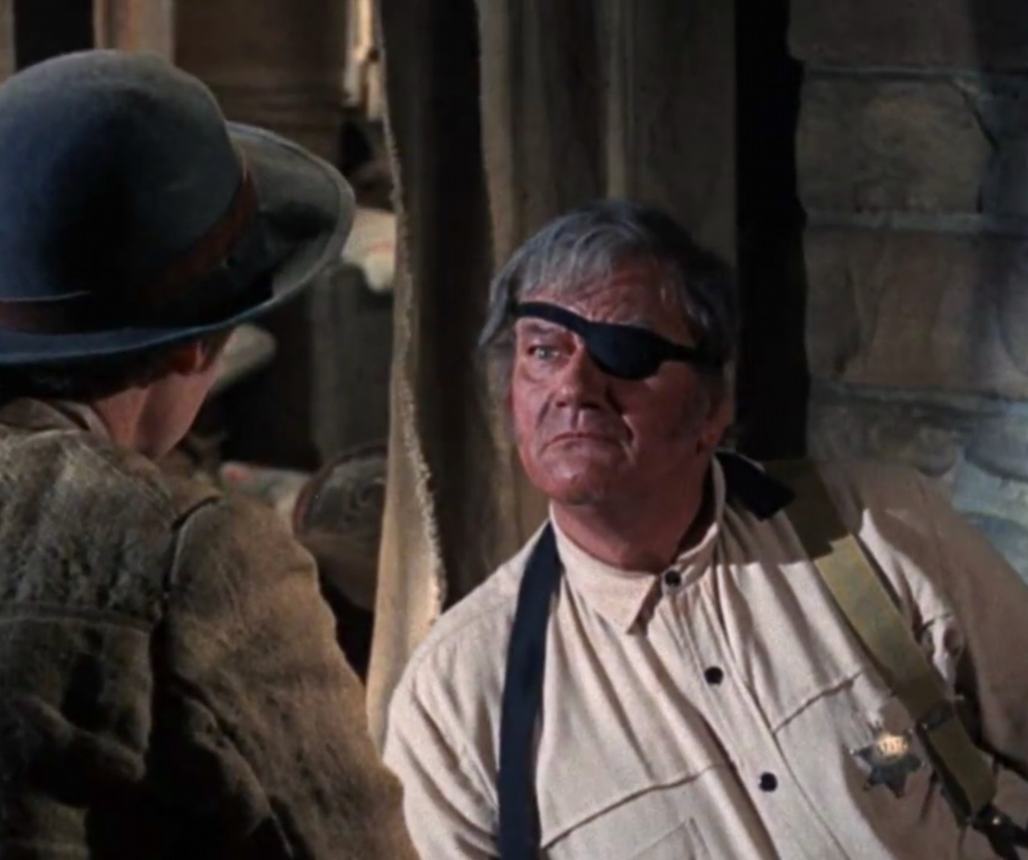
Grit
“Grit” isn’t about wearing spurs, nor is it about food down south.
It’s about doing something difficult, on purpose, usually over a significant period of time
Notes:
Image from cinema.theiapolis.com

Slide 31

Grit
“Bravery amidst opposition, determination regardless of the difficulties, doing hard stuff” ~Jon Acuff
Notes:
Image from www.telegraph.co.uk

Slide 32
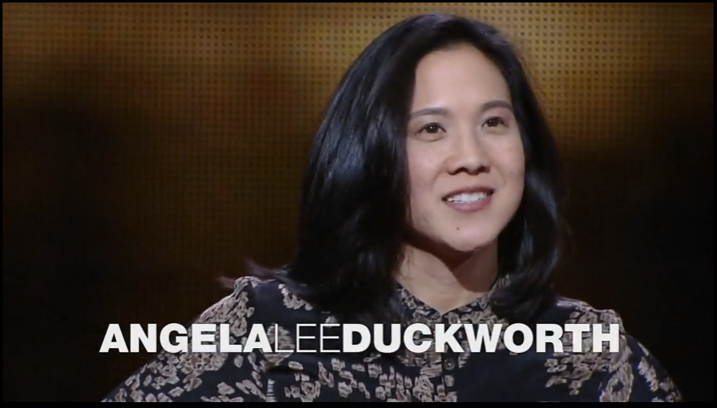
Notes:
Click the screen to watch this video.
https://www.ted.com/talks/angela_lee_duckworth_the_key_to_success_grit?language=en
Time: 6:12

Slide 33
Fixed Versus Growth Mindsets
Fixed=Your qualities are fixed in stone
Growth=Belief that your basic qualities are things you can cultivate through your efforts
~Dweck, 2006

Slide 34
In-class activity: 12 Item Grit Scale
How is your “grit”?
Type the URL on your device and take the quiz:
https://goo.gl/fT9gB3
(Just put your year of school when it says “Junior or Senior?”)
Notes:
1 minute

Slide 35
Reflect
Was the quiz accurate? Relevant?
What are you going to do with these results?

Slide 36

"Perhaps the most valuable result of all education is the ability to make yourself do the thing you have to do, when it ought to be done, whether you like it or not. It is the first lesson that ought to be learned and however early a man's training begins, it is probably the last lesson that he learns thoroughly"
~Thomas Henry Huxley

Slide 37
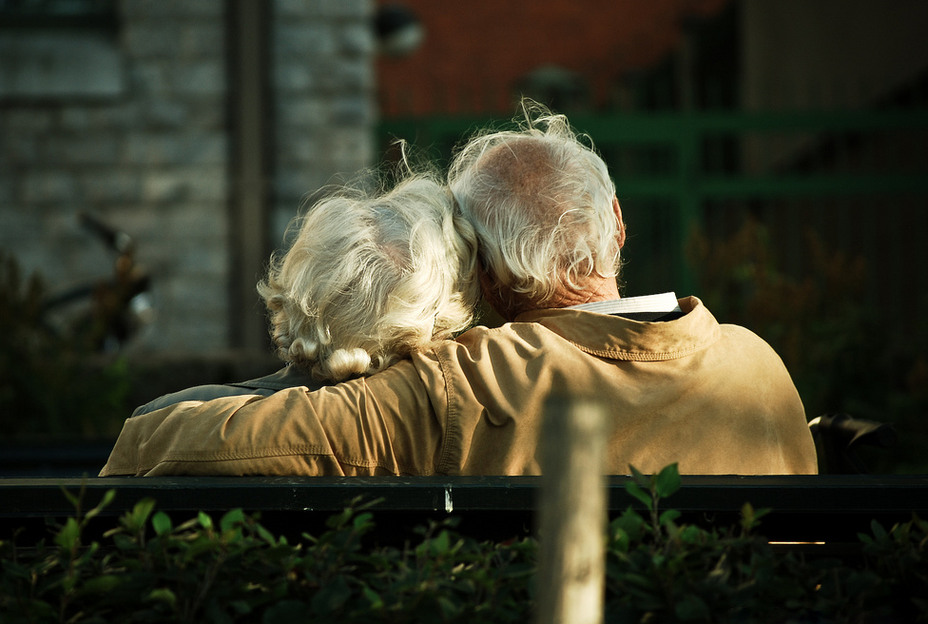
Bottom-Line
One of life’s greatest lessons is learning to do difficult things, especially when we don’t want to
Continue to work on this throughout your life
Notes:
Image from en.wikipedia.org

Slide 38
HW
Think – what do you want now? What do you want to have after college?
Think about what you’ll want in a new place
Can you do any of those things in your current place?
Look for opportunities to increase your grit

Slide 39
Additional Resources
http://acuff.me/hustle_rule1_grit/ (John Acuff, “the Three Rules of Hustle”)
Videos on buying a house (Realtor.com)
https://www.youtube.com/watch?v=8TQC987BSiU
https://www.youtube.com/watch?v=kEbiQiwLx3I
https://www.youtube.com/watch?v=lZtc7c_eDds
https://www.youtube.com/watch?v=R6uVr6lHTqI
https://www.youtube.com/watch?v=Ouw_zxTXZnM
Notes:
These resources have information and examples for effective cover letters and resumes

Slide 40

Content (not images or videos) copyright information:

